Slide 1
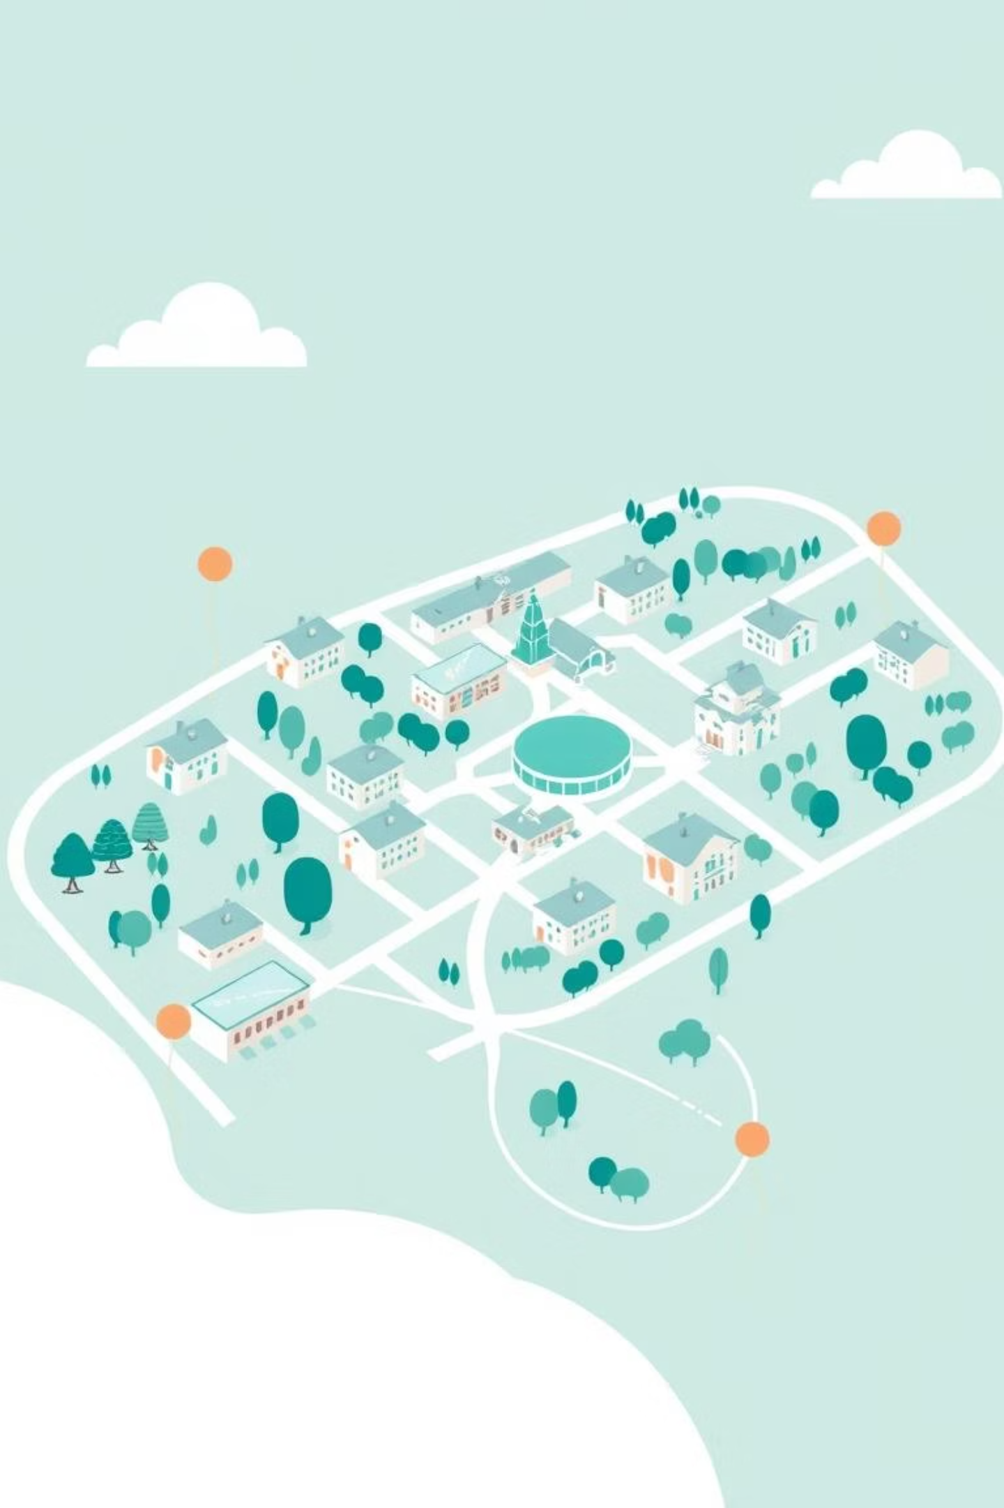
A Centralized Management System: An Integrated Smart Campus Architecture
Authors:
Syed Zain Ali Shah Bokhari [2024623]
Syed Ali Hassan [2024616]
Shayan Rizwan [2024585]
Hafiz Usman Abdullah [2024190]
Affiliation: GIKI, Topi, Swabi, Khyber Pakhtunkhwa, Pakistan

Slide 2
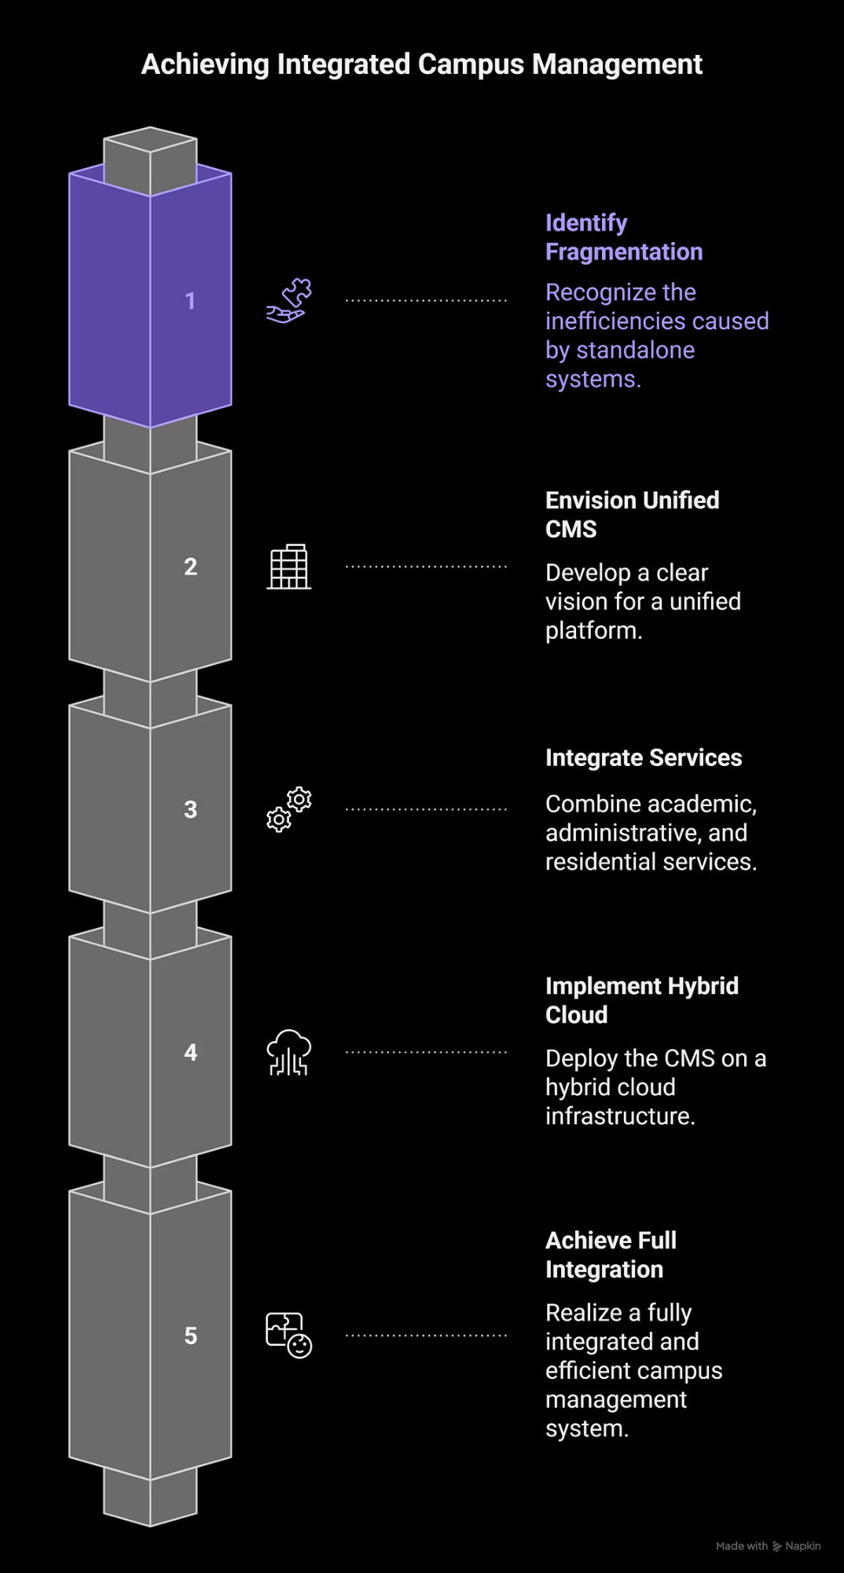
The Imperative for an Integrated Campus Management System (CMS)
Problem: GIKI's current fragmented digital systems and manual processes hinder efficiency.
Vision: A unified CMS to replace standalone systems (LMS, administrative portals).
Core Goal: Integrate academic, administrative, and residential services into a single, hybrid-cloud platform.
Key Driver: GIKI's status as a fully residential university creates a unique need for integrated physical-digital management.

Slide 3

Smart Laboratories: Multi-Layer Architecture
Concept: Transforming labs into intelligent, data-driven research environments.
Layer 1: IoT Sensor & Actuation Layer:
Universal Sensors: PIR occupancy, temperature/humidity (DHT22), air quality (MQ135), smart energy meters.
Domain-Specific Sensors: Gas leak detectors (Chemical), current/voltage sensors (Electrical), strain gauges (Civil).
Asset Tracking: RFID/BLE tags for high-value equipment and inventory tracking.
Layer 2: Connectivity Layer:
Hybrid network using BLE/Zigbee within labs and LoRaWAN/Wi-Fi 6 for campus-wide data transmission.

Slide 4
Smart Laboratories: AI Analytics & User Experience
Layer 3: Centralized Cloud/Edge Analytics & AI:
Predictive Maintenance: AI models forecast equipment failure (e.g., from vibration data).
Safety & Compliance: Computer Vision (CV) detects unsafe practices; logs fume hood data.
AI-Driven Experimentation: From AI-assisted experiments to fully autonomous "self-driving labs."
Layer 4: Application & Interface Layer:
Unified, role-based dashboards for students and managers.
Mobile & AR Integration: Apps for booking, push notifications, and AR guides for complex equipment.
Remote & Virtual Access: Cloud platforms enable remote experiment control.

Slide 5
Smart Campus Governance: Data, Security, and Resilience
Concept: Managing the campus as an intelligent Cyber-Physical System (CPS).
Data Governance:
Policies for managing Big Data from IoT sensors, ensuring quality, availability, and student privacy.
Cybersecurity & Resilience:
Challenge: Large attack surface from interconnected IoT devices.
Solutions: Deep Learning (DL) for sophisticated Intrusion Detection Systems (IDS). Exploration of Blockchain for decentralized, tamper-proof data security.

Slide 6
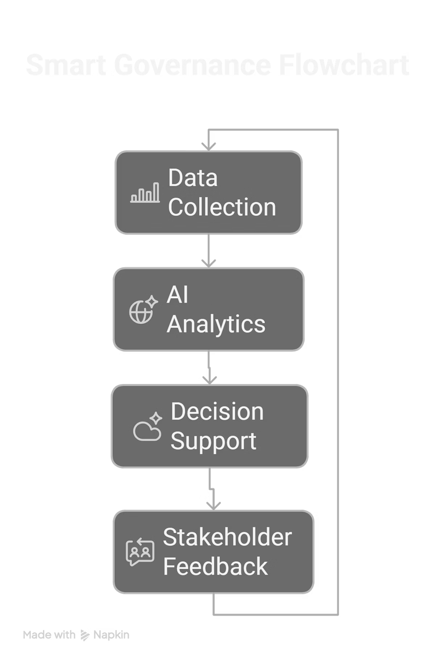
Smart Governance: Automated Management & Stakeholder Participation
Automated Management & Decision Support:
Use of AI and analytics for predictive and proactive management.
Centralized dashboards for optimizing traffic, maintenance, and emergency response (Management Decision Support Model).
Stakeholder Participation & Transparency:
Collaborative environment with open decision-making.
Human-centered approach ensuring technology deployments are user-driven.

Slide 7
Smart Classrooms: Environmental Intelligence & Automation
IoT Infrastructure:
Networks of environmental (DHT22, MQ135), occupancy (PIR, Wi-Fi, seat sensors), and light/noise sensors.
Edge & Cloud Processing:
Real-time local processing (edge) combined with cloud analytics.
Ambient Intelligence & Smart Control:
Systems auto-adapt lighting, HVAC, and blinds for different scenarios (lecture, exam).
Predictive analytics pre-condition rooms, reducing energy use by up to 27%.

Slide 8
Smart Classrooms: AI, Immersive Tech, and Learning Analytics
AI-Powered Performance Prediction:
ML models (Random Forest, Neural Networks) analyze LMS/behavioral data to identify at-risk students with >90% accuracy.
Real-Time Classroom Intelligence:
Sensor fusion and AI dashboards assess engagement via eye-tracking, posture, etc.
Interactive & Immersive Tech:
Smart Boards: 4K multi-touch displays, annotation, wireless sharing.
AR/VR: 3D visualizations, immersive learning, haptic feedback for distributed teams.
Ethical Framework:
Mandates transparency and bias audits for all AI systems.

Slide 9






Smart Offices: Integration with Campus-Wide Design Pillars
Outline the six foundational pillars for smart offices/campuses:
Robust Network Infrastructure:
IoT Devices & Sensing:
High-bandwidth for unified device management.
Smart lighting, occupancy sensors, RFID/QR codes.
Data Analytics Engines:
Mobile-first Interfaces:
For optimization, safety, and real-time decisions.
For booking, notifications, and digital IDs.
Sustainability & Green Ops:
Continuous Feedback & Engagement:
Energy management, smart parking, waste tracking.
Dashboards and surveys for iterative improvement.

Slide 10
From Vision to Reality: The Unified CMS & Implementation Path
The CMS: The Digital Heart of the Smart Campus
The Centralized Campus Management System (CMS) is the unifying platform that connects all domains, turning isolated systems into a single, intelligent ecosystem.
Unifies data from IoT sensors, AI, and user interactions.
Powers a single mobile dashboard for all stakeholders.
Built on a secure, scalable hybrid-cloud architecture.
A Phased Implementation for Success
A strategic, staged rollout ensures tangible results, manages risk, and builds momentum.
Phase 1: Core & Pilot
Phase 3: Optimize & Innovate
Deploy essential CMS & run Smart Classroom pilots.
Full ecosystem optimization and R&D.
1
2
3
Phase 2: Scale & Integrate
Campus-wide rollout and integrate Smart Labs.

